Slide 1
ShARED POWER
GROUP- FUEGO
Group Members:
Arya Elpula- 1714603
Marcus Bennett - 1818787
Shehu Shehu - 1817622
Marian Terchila – 1819263
Shehu Abubaker - 1911192
Notes:
Arya

Slide 2
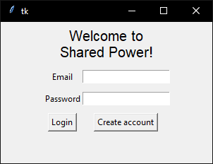
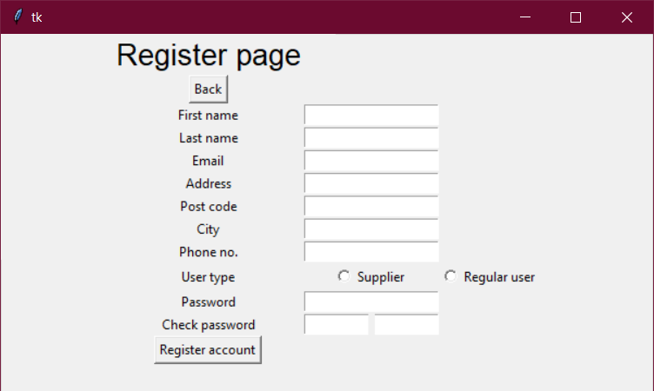
startup page
The welcome page is initiated with a Login/register page, with the user having to decide to create a new account or log in with a registered account.
This page utilizes 3 python files that are linked with the functioning buttons; ‘Login’ and ‘Create account’.
We have included text fields to the register form and the data is saved to the database once the submit button is clicked.
Login page simply asks for the username and password and checks if they match a user in the database.
Notes:
Arya

Slide 3
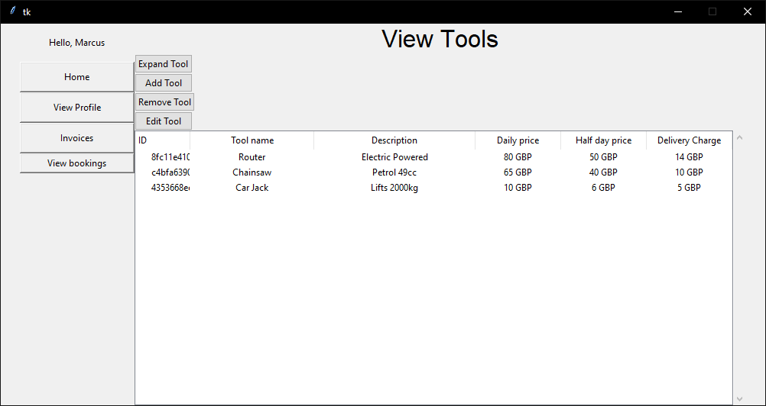
Tool Owner MAIN PAGE
Once logged in, the owner is able to view all of their tools that are registered to the Shared Power system.
On the left lies the user’s main menu, which gives them access to the rest of the program.
As well as viewing the tools owners may add, remove, edit and view tools in more detail.
The displayed data is queried directly from the database and loaded into a table every time the home page is loaded.
Notes:
Marcus

Slide 4
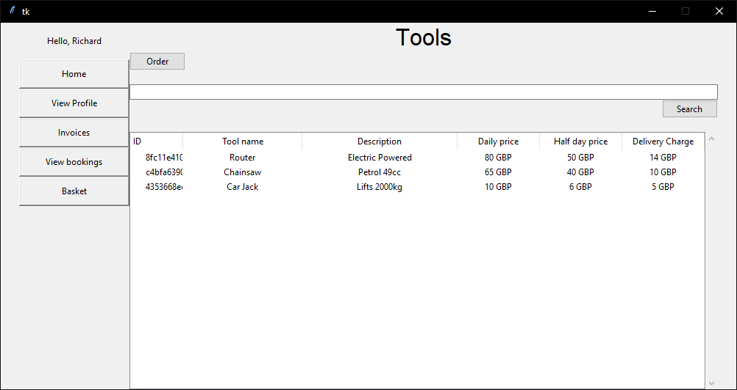
Customer main page
Like the owner page, the customer page has a user’s main menu. The basket page has been added to the menu, however.
Customers can view tools that are available to book, seeing their names, descriptions and booking costs.
A search bar allows users to refine the tools displayed in the table.
By using the order button, customers can specify the details of the tool booking and add it to their basket.
Notes:
Shehu

Slide 5
Database
We created a database solution and used SQLAlchemy.
A class system helps configure and create the database and its relationships through SQLAlchemy.
While the Python-to-SQL is managed by SQLAlchemy, the database itself uses sqlite.
The database engine can be easily changed, as sql is fairly universal.
Notes:
Raheem

Slide 6
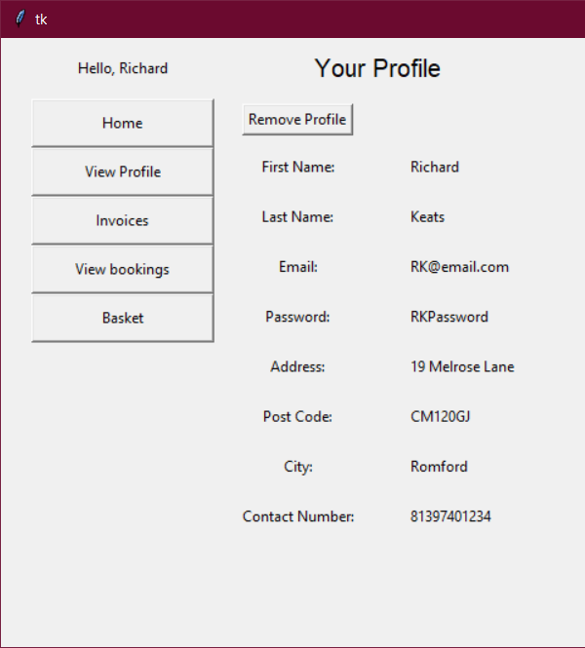
View function
This function was used in both user’s menus and displays information of the user.
The data related to the user is queried directly from the database and so is always up-to-date.
The user is also able to remove their profile from the system. Which will remove their personal details, tools (if they are an owner) and bookings related to them from the database.
This page is displayed differently than most other pages as there is only one record (the user) to display.
Notes:
Ashman

Slide 7
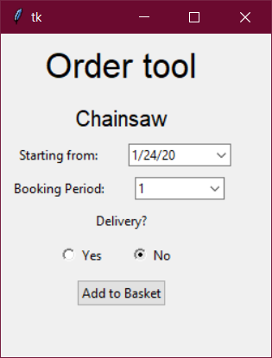
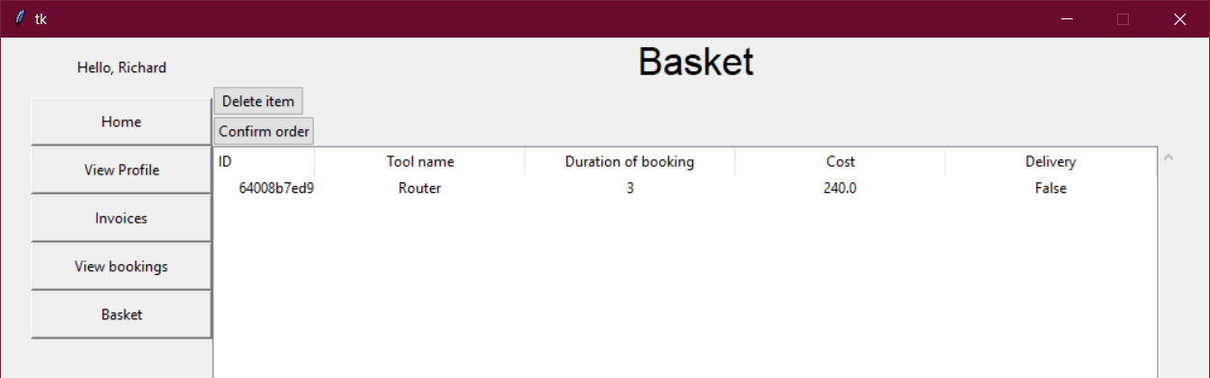
Basket
Before committing to a booking, the customer adds tools to their basket through the ‘Order tool’ window.
They select the starting date of the booking, the duration of the booking, and the delivery or collection.
The tool is then added to the basket, where they can either remove tools from their basket. Or they can confirm all tools in their basket and commit them to bookings.
Notes:
Marcus

Slide 8
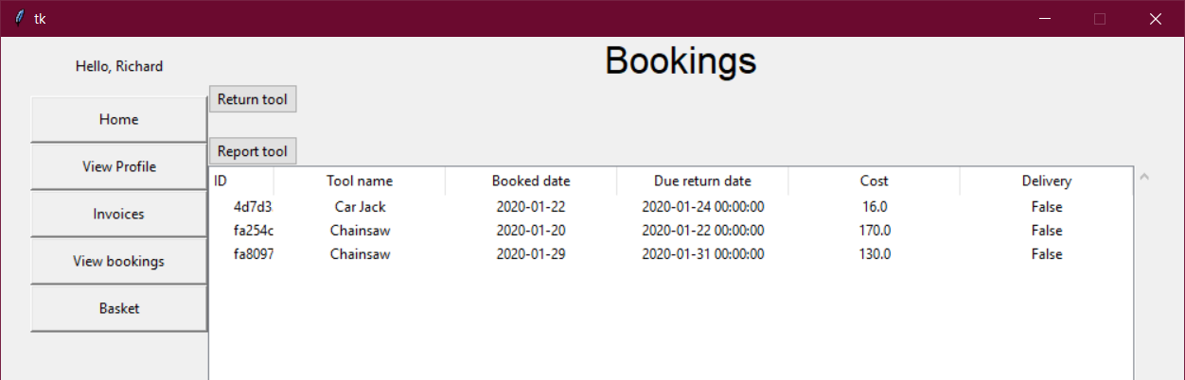
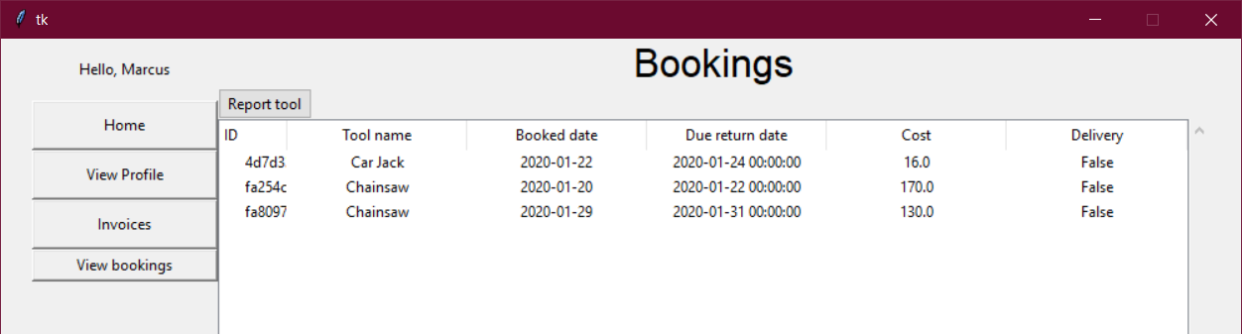
Bookings page
Both users are able to access a booking page, customers and owners.
For the customers, all booked tools become visible, showing the details of the tool.
For owners, their own personal tools that have been booked by customers are shown instead, with the same details available.
Customers have the option to submit the return of a tool, then owners can confirm the return or report the tool as lost if it is not actually returned.
Both users can, however, report a tool at any time. The insurance company is contacted, and they resolve the issue.
Notes:
Marian

Slide 9
Things we could improve on
Fully implemented report system
Picture displays
Downloadable invoices
Edit profile
As a group:
Slightly rushed project
Better communication
Notes:
Arya & Marcus

